Slide 1
Entertainment Data Analytics
By Sakshi Sanjeeva Hegde
UNID: UMIP8273

Slide 2
Problem Statement, Solution and Methodology:
Problem Statement:
Normal life can be stressful, and people need to relax. Being entertained by others is a wonderful way to take some time out of life. It can reduce stress and make life's issues easier to face. The media and entertainment industry consists of film, television, radio and print. These segments include movies, TV shows, radio shows, news, music, newspapers, magazines, and books. The entertainment industry is a group of sub-industries devoted to entertainment. The entertainment industry is used to describe the mass media companies that control the distribution and manufacture of mass media entertainment.
Solution for the problem statement:
In order to analyze which entertainment industry and entertainer was popular among people who succeeded in entertaining them, so that they were being relived temporarily from their busy and stressful schedules, then we need to find out who received most awards for entertaining people for years.
Methodology:
Using Python for data-preprocessing as well as for concatenation purpose of three dataset in the form of Excel sheet.
Later on, using Excel to add more relatable features in order to feasibly understand the relation between different features and analyze them
Finally, by using Tableau, will perform data analytics to generate interactive charts and dashboard to understand relationship mainly between an entertainer and number of times he or she won the awards for the best performance.

Slide 3
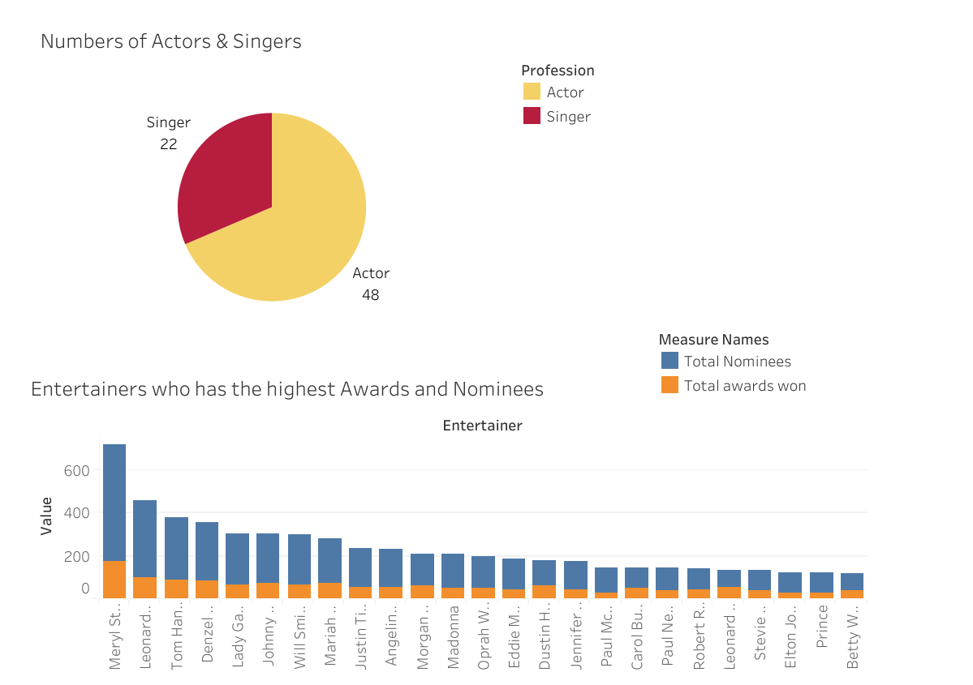
Dashboard
In the above dashboard, I analyzed the features by using Pie chart and stacked bar plot.
I analyzed how many numbers of entertainer are there from Music and Film industry.
The stacked bar plot explains the entertainer who won more awards and number of times they were nominated.
So, Meryl Streep happens to be in the top spot in this case following Leonardo DiCaprio.

Slide 4
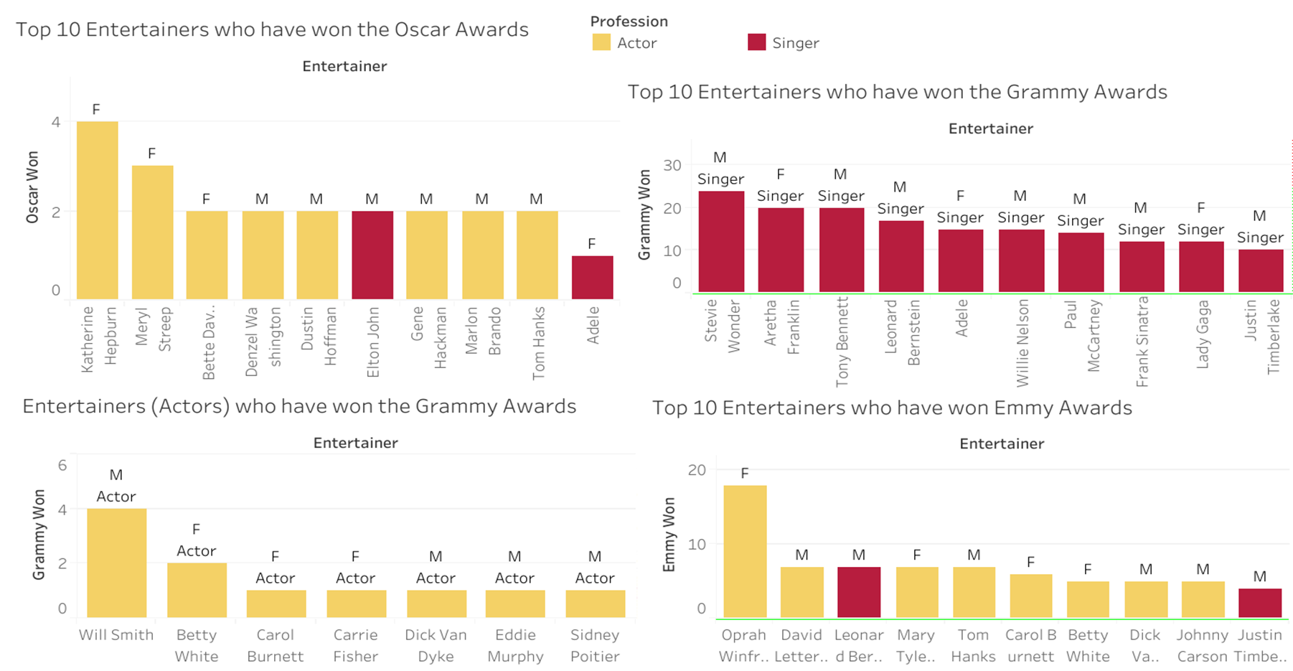
Dashboard – Top 10 Entertainers who have won the Awards

Slide 5
The dashboard shows the bar plots related to which entertainer from an entertainment industry won the Oscar, Grammy and Emmy Awards
Based on this analysis I had found out that –
Katherine Hepburn have won more Oscar Awards, following Meryl Streep and Adele have won the least among them
Most of the entertainers who have won the Oscars are the actors and Dustin Hoffman and Adele are singers by profession to won Oscar for their album.
In case of Winning the most Grammy awards, I have found out that top ten entertainers are from music industry who have won more Grammy awards. Also, there are actors who have the Grammy Awards.
In case of Winning the most Emmy Awards, I have found out that Oprah Winfrey have won the most awards followed by David Letterman and the least awards won by the Justin Timberlake. Also, most of the actors have won the Emmy Awards compared to singers.
Also, I have found out that there are more Male Entertainers than Female Entertainers.

Slide 6
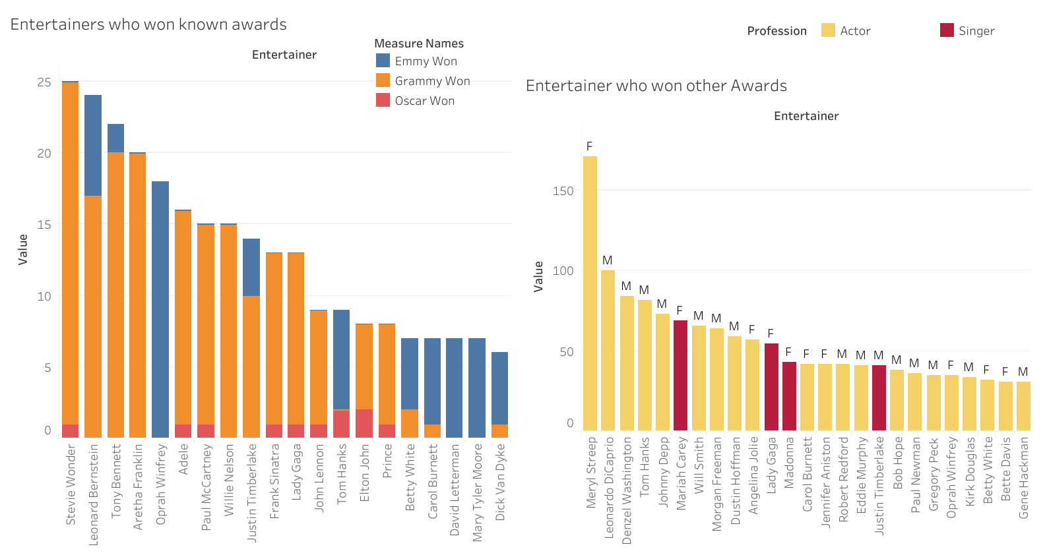
Dashboard – Entertainers who have won the known and Other Awards

Slide 7
Analyzing the Entertainers who have won the Awards and Other awards. Based on this analysis I found out that –
I found out that Steve Wonder occupies the topmost spot in the known awards category. Known awards comprises of Grammy, Emmy and Oscar. He have won the total 25 awards out of which he won more Grammy awards.
Meryl Streep have won more than 150 awards in other awards category which does not include Grammy, Emmy and Oscar Awards.

Slide 8
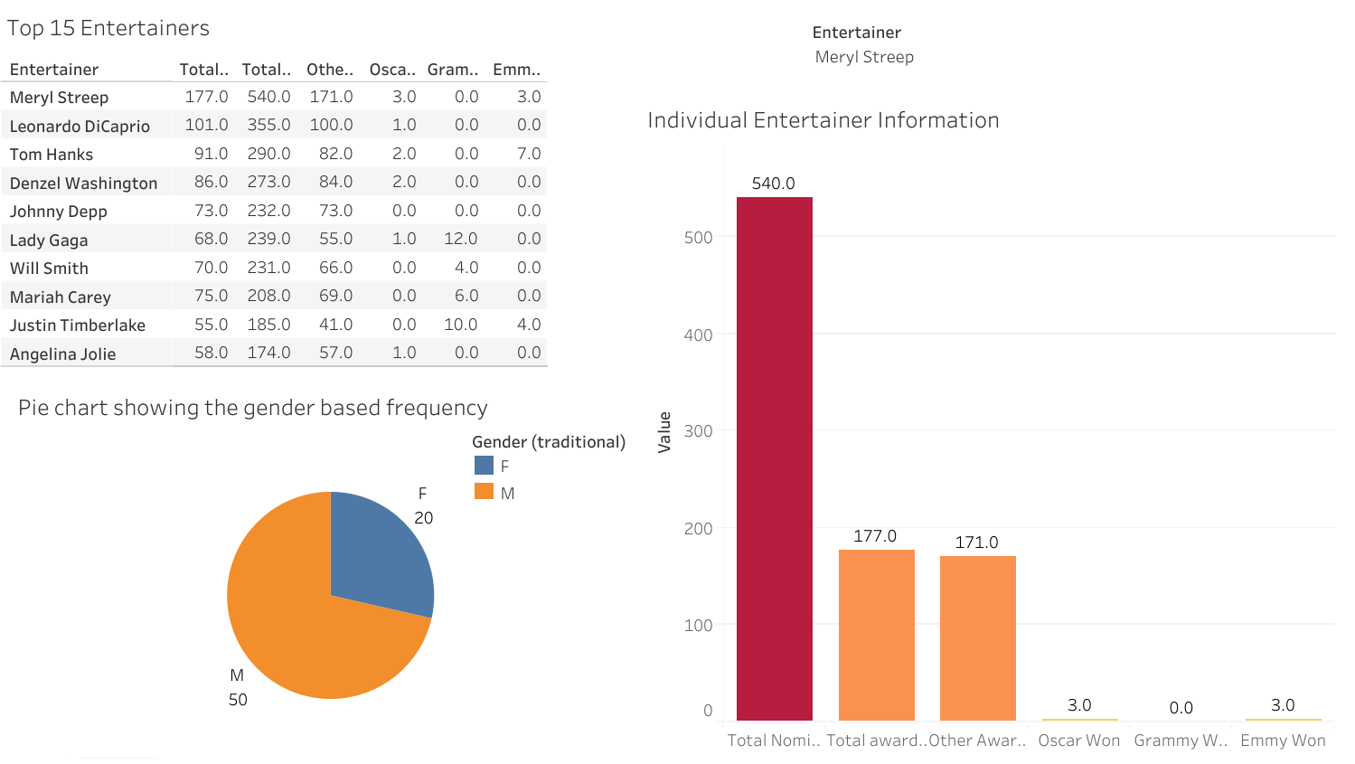
Dashboard – Top Entertainer

Slide 9
I had analyzed table, pie chart as well as the bar plot. Based on the analysis I found out that –
Meryl Streep have won the maximum the awards including known and other awards.
Pie charts indicates that there less number of female entertainers compared to male entertainers.
Meryl Streep was nominated 540 times for the award, she have won the 177 total awards including other awards. She has won 174 other awards, three Oscars, three Emmy awards and zero Grammy awards.

Slide 10
Conclusion
Meryl Streep is the top Entertainer or Actor in the film industry.
She did work in film Deer Hunter which was a breakthrough in 1978.
She was nominated for the Grammy but didn’t won any.
She ranked top when it comes receiving other awards
She won three Oscars which shows that she is talented actor who succeeded in entertaining people through her movies like Deer Hunter.
I also found out that actors won more awards for their hit movies than singers. So, film industry entertained people more than the music industry.

Slide 11
Thank You

